Slide 1

Presentation title
Deployment with ARM templates and GIT
IT Innovation Series
Speaker Name
Speaker Name
#InnovateIT

Slide 2

Agenda
Scenario
Objectives
Technology overview
Lab environment and exercises

Slide 3
Scenario
Contoso, Inc. has successfully been using Azure for some time now. However, Contoso's use of Azure has, up until now, been limited to the use of the Azure Service Management API.
The Service Management API allows Contoso to manage Azure resources, such as storage accounts, virtual machines, and virtual networks as individual entities. The Service Management API model serves Contoso well, but it does not reflect the fact that these entities are often, in fact, related and independent parts of a larger, single entity.
In contrast to the Azure Service Management API, the Azure Resource Management API allows organizations such as Contoso to deploy, manage, and monitor Azure resources as a single group. In addition to this benefit, ARM makes it possible to use declarative templates to define and provision resources in a deployment. Furthermore, Contoso could implement Role-based Access Controls (RBAC) to provide greater security. Finally, using ARM, Contoso would be able to apply tags to resources to organize them logically within the same subscription.
Because of the benefits that Azure Resource Management can provide to Contoso, you have been asked to explore how ARM can be used to deploy and manage resources. Specifically, you have been asked to learn how templates can be used to define and deploy Azure Resources.

Slide 4
Scenario
Contoso, Inc. has successfully been using Azure for some time now. However, Contoso's use of Azure has, up until now, been limited to the use of the Azure Service Management API. The Service Management API allows Contoso to manage Azure resources, such as storage accounts, virtual machines, and virtual networks as individual entities. The Service Management API model serves Contoso well, but it does not reflect the fact that these entities are often, in fact, related and independent parts of a larger, single entity.
In contrast to the Azure Service Management API, the Azure Resource Management API allows organizations such as Contoso to deploy, manage, and monitor Azure resources as a single group. In addition to this benefit, ARM makes it possible to use declarative templates to define and provision resources in a deployment. Furthermore, Contoso could implement Role-based Access Controls (RBAC) to provide greater security. Finally, using ARM, Contoso would be able to apply tags to resources to organize them logically within the same subscription.
Because of the benefits that Azure Resource Management can provide to Contoso, you have been asked to explore how ARM can be used to deploy and manage resources. Specifically, you have been asked to learn how templates can be used to define and deploy Azure Resources.

Slide 5
Objectives
You will:
Understand Azure Quickstart templates
Learn about GitHub and GIT repositories
Learn how to configure Visual Studio Code to use GIT
Learn how to customize a template and its related parameters JSON file using Visual Studio Code to meet your specific and additional requirements
Learn how to stage and commit changes to the local and remote GIT repository

Slide 6
Technology overview

Slide 7



Azure Resource Manager (ARM)
This slide could use build/animation. It builds from top to bottom. Azure/Commandline/Visual studio all hit the API to interact with resource manager groups which in turn interact with the different rest points. The link https://azure.microsoft.com/en-us/documentation/articles/virtual-machines-azure-resource-manager-architecture/
explains what this slide is supposed to get across.
RESOURCE MANAGER
Consistent management layer
Tools
SERVICE MANAGEMENT API
Microsoft Azure
Command line
Visual Studio
ADFS
AAD
Contoso
Curated extensions
Cloud
On-premises
RESOURCE PROVIDER CONRACT
Provider rest points
DB
Notes:
Azure Resource Manager overview
https://azure.microsoft.com/en-us/documentation/articles/resource-group-overview/
Understanding Resource Manager deployment and classic deployment
https://azure.microsoft.com/en-us/documentation/articles/resource-manager-deployment-model/
Resource Manager Architecture
https://azure.microsoft.com/en-us/documentation/articles/virtual-machines-azure-resource-manager-architecture/

Slide 8
Resource Manager example
Classic model (v1)
Resource Manager (v2)
Cloud service
Resource group
Load balanced
endpoint with IP address
Back-end pool (NICs)
VM with IP address
Storage account
VM
NIC
VM IP address
VNet
Load Balancer
LB IP address
Disk (blob)
Subnet
Reference
Reference
Reference
Virtual network
Reference
Storage account
Virtual network
Storage account
Depends on
Reference
Disk (blob)
Subnet-1
Network Security Group ACLS
(deployed to VM, NIC, or Subnet)

Slide 9
Azure Resource Manager templates
ARM templates can:
Simplify deployment
Simplify roll-back
Provide cross-resource configuration and update support
Be used as a learning tool to build to suit
Azure templates are:
Source file, checked-in
Specifies resources and dependencies (VMs, websites, DBs) and connections (configuration, LB sets)
Configurable parameters for input/output
ARM template
SQL-A website
Repeatable configuration
Configuration→ Resource Group
[SQL CONFIG] VM (2x)
Depends on SQL
Depends on SQL
DEPENDS ON SQL
SQL-A
Website
Virtual Machines
DB
SQL configuration

Slide 10
Common use cases for ARM templates
Enterprises and system integrators
Internal software development teams
Delivering an application
Corporate IT
Delivering a capability or cloud capacity
Cloud Service Vendors (CSVs)
Support different multi-tenancy approaches
Distinct deployments per customer
Within the CSV’s subscription
“Bring your own subscription” model that uses customer subscriptions
Scale units within a central multi-tenant system
Support ability to make available via the marketplace
All deploy known configurations/SKUs/VM sizes

Slide 11
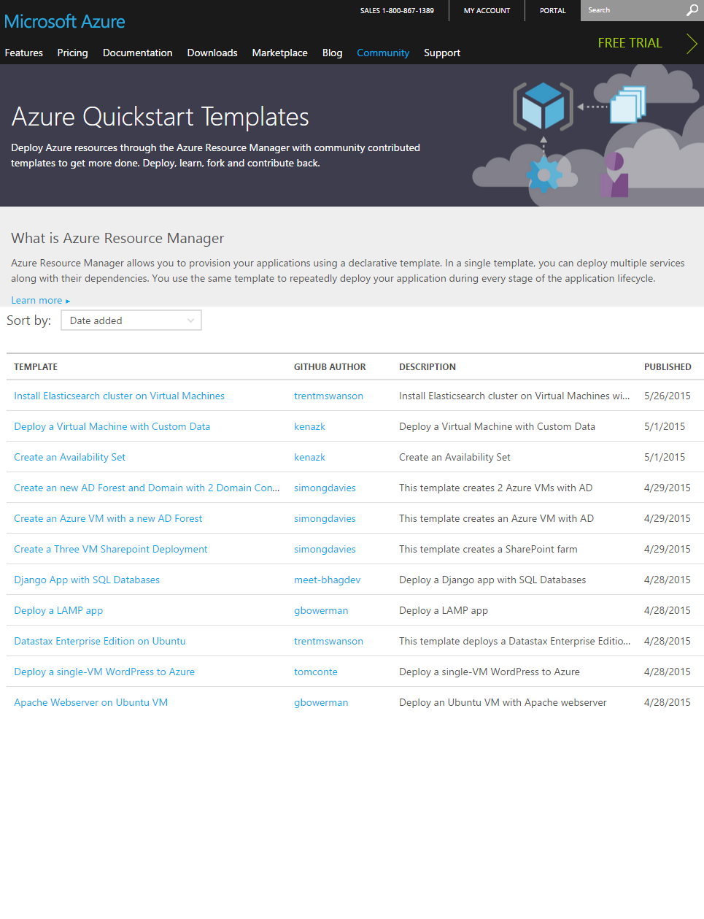
Getting started with Azure templates
Wide range of Quickstart templates
Indexed on Azure.com
GitHub repo
Community and Microsoft contributed
Integration of IaaS with Azure Services
Many examples available @ https://github.com/Azure/azure-quickstart-templates
Notes:
Best practices for designing Azure Resource Manager templates
https://azure.microsoft.com/en-us/documentation/articles/best-practices-resource-manager-design-templates/
Also, see Appendix for additional slides on this topic

Slide 12
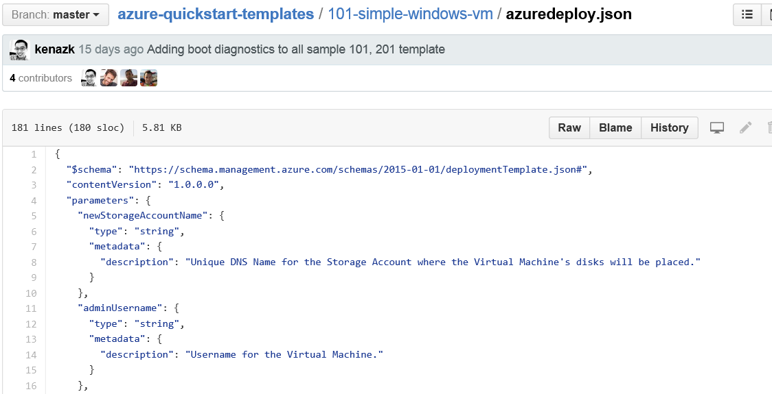
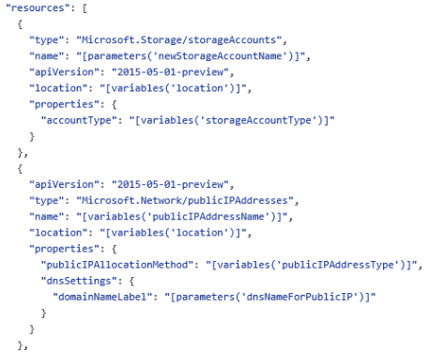
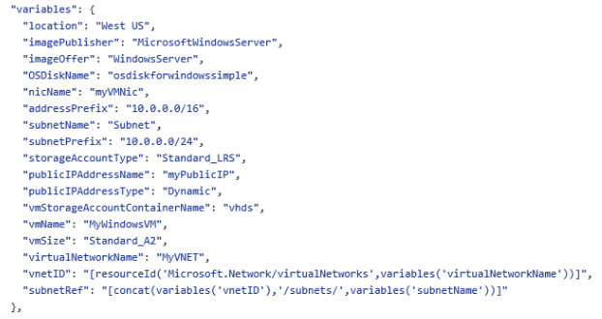
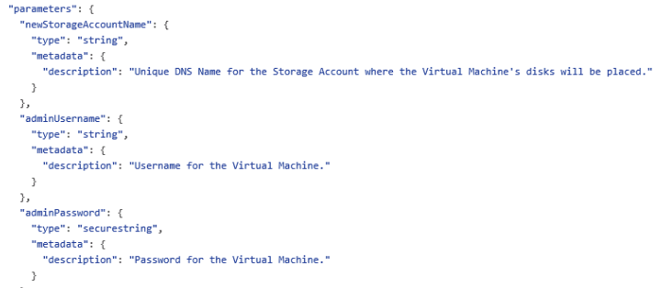
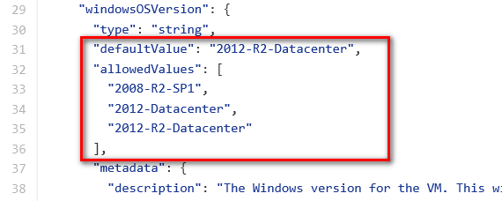
JSON files—simpler than they look Schema, content version, parameters, variables, resources, and outputs
Notes:
A JSON template file is a text file that contains descriptions of the resources, configurations code and extensions. JSON templates are idempotent, which means that they can be run multiple times without changing the outcome beyond initial deployment. A consequence of this characteristic is that templates can be used to upgrade applications, for example, by scaling out applications with additional VMs. You modify the template to include the specifications for the additional virtual machines. When you deploy the template, Azure Resource Manager will recognize the resources that have previously been deployed and create only the resources that have been added.
A JSON template is divided into sections:
<CLICK> The $schema (a required element that provides the location of the file that describes the version of the template language) along with a required element that provides the version of the template
The schema reference is used by intelligent JSON clients to determine the schema that is applicable to the JSON file and to provide additional functionality such as autocomplete and intellisense.
<CLICK> Parameters (optional elements that define values that are passed in when the template is executed)
The value for the Parameters key is an array of parameter objects that representing the dynamic input for the JSON template. Each of the parameter objects has a name that is used pass values in at runtime and is referenced within the JSON itself in other sections. For example, "NewStorageAccount" is the name of the parameter that is supplied as an input and used to provide the name of the storage account resource specified in the JSON file.
<CLICK> Variables (optional elements that define the values that are used when template is executed)
<CLICK> Resources (a required element that defines the resources that are deployed or updated in a resource group); and
This slide doesn’t show it, but you can also have an optional Outputs section that defines values that are returned after a deployment
<CLICK> A JSON file is constructed of key/value pairs. For example, in the image above, "ContentVersion" is the key and "1.0.0.0" is the value. A key is always a string enclosed in quotation marks. A value can be a string, securestring, number, boolean expression, array, or object. A JSON object is enclosed in curly braces, "{ }". In a key/value pair the key is always followed by a colon. Key/pairs are separated by commas.
A JSON template may also contain functions and expressions. Expression are enclosed in square brackets, "[ ]', and can appear anywhere in a JSON string. Functions calls have the format functionName(arg1,arg2,arg3). Properties are referenced using the dot and index operators.
The lab provides notes with additional details regarding specific parameters, variables, resources, etc.
Authoring Azure Resource Manager templates
https://azure.microsoft.com/en-us/documentation/articles/resource-group-authoring-templates/

Slide 13
Passing state—common parameters
Name (string values) | Description
Location | The location where the resources will be deployed from a constrained list of Azure regions
storageAccountNamePrefix | Unique DNS name for the storage account where the VM’s disks will be placed
virtualNetworkName | For deployments that create a new virtual network, the name to use for creating that resource. For deployments that use an existing virtual network, the name of the VNet to deploy into
username | User name for the virtual machine(s) and potentially the application(s). More than one user name can be requested from the end user, but at least one must be prompted
password | Password for the virtual machine(s) and potentially the application(s). More than one password can be requested from the end user for different VMs or applications, but at least one must be prompted
tshirtSize | The named scale unit size to provision from a constrained list of offered t-shirt sizes For example, “Small”, “Medium”, “Large”
enableJumpbox | Parameter that identifies whether to enable a jumpbox for the environment Values: “enabled”, “disabled”

Slide 14
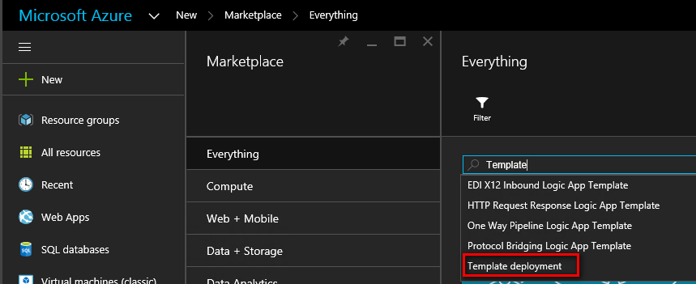
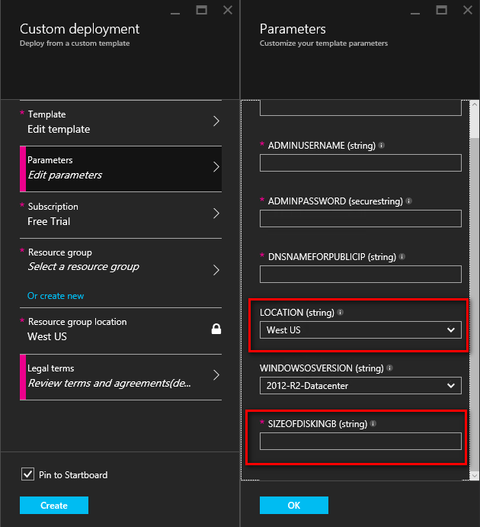
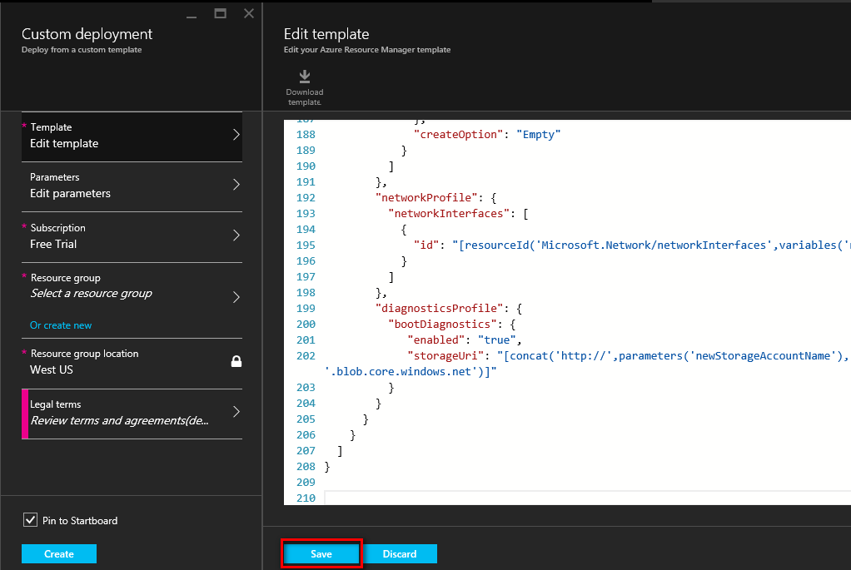
Deploying custom JSON files
New-AzureResourceGroupDeployment -DeploymentName "Simple-VM" -ResourceGroupName RG-AZITCAMP -TemplateFile "C:\GitHub\Templates\101-simple-windows-vm\azuredeploy.json
Notes:
The Lab walks through this process from start to finish
Deploy an application with Azure Resource Manager template
https://azure.microsoft.com/en-us/documentation/articles/resource-group-template-deploy/

Slide 15
Tools to help manage templates
GitHub
Visual Studio Code
NotePad/NotePad++
Notes:
This is a placeholder slide to allow for an explanation of why Git/Github/VSCode are being discussed in this session.

Slide 16
GIT
A widely used version control system for software development
A distributed revision control system with an emphasis on speed, data integrity, and support for distributed, non-linear workflows
A full-fledged repository with complete history and full version-tracking capabilities, independent of network access or a central server
Notes:
https://en.wikipedia.org/wiki/Git_(software)

Slide 17
GitHub
https://github.com
The largest code host on the planet with over 27.6 million repositories
Every repository comes with the same powerful tools
Tools are open to the community for public projects and secure for private projects
Allows for creation of a GIT Desktop and cloned repository

Slide 18
Visual Studio Code integration with GIT
Open your team repository in Visual Studio
Clone your repository
Create a new app
Confirm your settings and add the app
Snapshot (commit) your code
Pull changes from your team
Push your local commits to the server
Notes:
Develop and share your code in Git using Visual Studio
https://www.visualstudio.com/en-us/get-started/code/share-your-code-in-git-vs

Slide 19
Lab environment and exercises

Slide 20
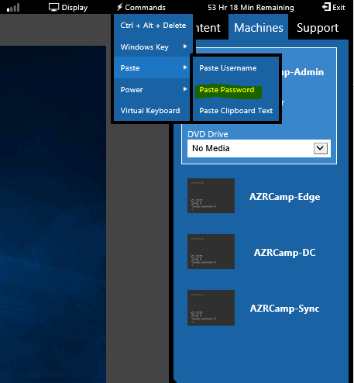
Lab environment
Aka.ms/itistudent
Password = Passw0rd!

Slide 21
Azure Boot Camp virtual machines
AZRCamp-Admin.contoso.com
(Windows 10; used for Azure Management)
AZRCamp-DC.contoso.com
(Windows Server 2012 R2; domain controller, DNS)
AZRCamp-Sync.contoso.com
(Used for synchronization in some labs)
AZRCamp-Edge
(Stand-alone Windows Server 2012 R2; RRAS)

Slide 22
Azure infrastructure
Prepare the Azure infrastructure
AZCampStart.ps1
Understand Azure templates and resource groups
Understand Azure Quickstart templates
Review a template from GitHub

Slide 23
Configure GIT repositories and Visual Studio Code
Create GitHub account and public repository
Configure GitHub desktop and clone repository
Examine Visual Studio Code integration with GIT and push commits to remote repository

Slide 24
In review: Session objectives and takeaways
You now:
Understand Azure Quickstart templates
Learn about GitHub and GIT repositories
Learn how to configure Visual Studio Code to use GIT
Learn how to customize a template and its related parameters JSON file using Visual Studio Code to meet your specific and additional requirements
Learn how to stage and commit changes to the local and remote GIT repository

Slide 25
Appendix additional technology slides

Slide 26
Thank you

Slide 27
Resources
Register for another IT Innovation Series event Further topics: Windows Server 2016, Windows 10 and more.
aka.ms/ITInnovation
Continue your learning Download this presentation, access online training and demos, try Azure for free.
aka.ms/ITInnovationResources
Know someone who wants to learn more about
the Cloud? Tell them to get started at the Microsoft Cloud Roadshow.
www.microsoftcloudroadshow.com

